Slide 1
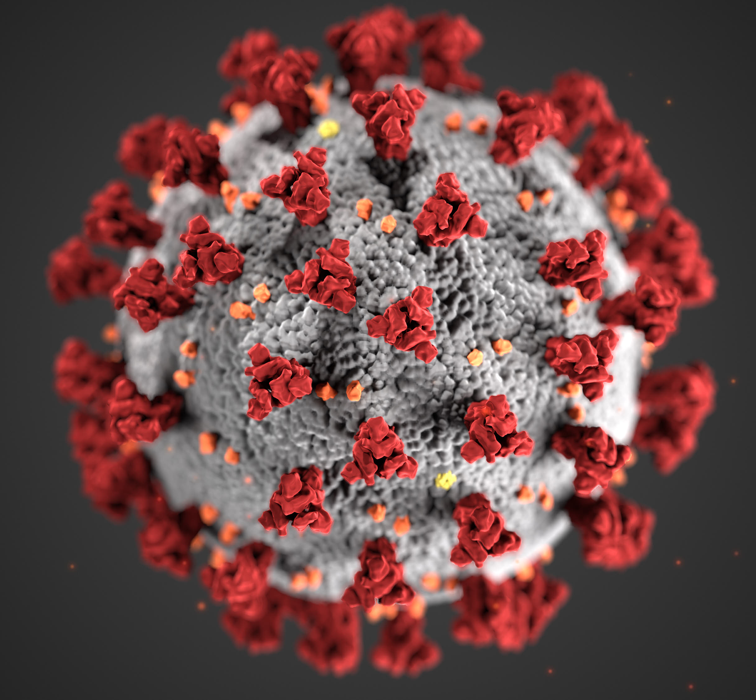
Studiu de caz Covid-19
Webinar, 28 Septembrie, 2020
Spitalul Cone Health
Christopher McKeown, BSN, RN, CCRN
Amanda Payne, RN, BSN, CCRN, SANE-A
Ann Councilman, DNP, MHA, RN-BC
Julie O’Neal, MSN, RN, NPD-BC, CEN
Parteneriatul Carolina de Nord - Moldova
Deborah Lekan, PhD, RN-BC
Nancy Hoffart, PhD, RN
Notes:
Welcome! We are so glad you have joined us on the North Carolina-Moldova Nursing Collaborative webinar on nursing care of Covid-19 patients. We must start by saying that the authors of this presentation have no affiliations or involvement with any organization or entity with any financial interest in the subject matter or materials discussed. There are no conflicts of interest to disclose.
Shall we do any more introduction here?
As a primer, the nursing collaborative is a bilateral agreement between Republic of Moldova and North Carolina signed in 1995. The collaborative is overseen by U.S. Embassy Office of Defense Cooperation and the U.S. State Department and N.C. Office of the Secretary of State. This program is part of the Partnership for Peace Program, which links U.S. states with former Soviet countries to facilitate development of democracy and cooperation in areas of military, economic, cultural, scientific, academic, and medical exchanges.

Slide 2
Obiective
1. Împărtășirea cunoștințelor actuale despre cele mai bune practici privind siguranța și îngrijirea medicală în timpul pandemiei Covid-19.
2. Prezentarea unui studiu de caz al pacientului internat cu Covid-19.
3. Descrierea simptomelor și complicațiilor frecvente ale infecției Covid-19.
4. Descrierea evaluării nursing și a planului de îngrijire pentru pacientul cu Covid-19.
5. Discuții privind rezistența asistenților medicali și îngrijirea de sine.
Notes:
Our team is very excited to get to share with you the nursing practices that were developed and utilized to care for Covid-19 patients in the United States. Included in this presentation we will discuss nursing interventions, medication and oxygen usage, personal protective equipment, hygiene and safety to care patients with COVID-19.
The objectives of this case study is to provide an example of how we use the nursing process to complete a nursing assessment, and develop the plan of care for the patient with COVID 19. We will also describe how we continue to assess the patient and make changes in the plan of care based on changes in the patient’s condition.

Slide 3
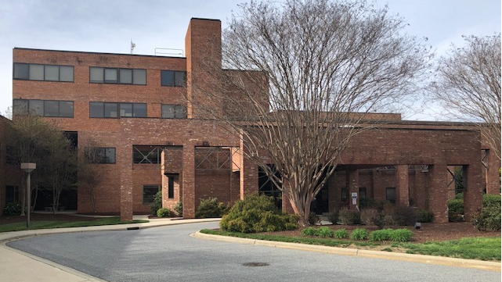
Spitalul Cone Green Valley Greensboro, Carolina de Nord
Notes:
First, I want to share with you an overview of Cone Green Valley Hospital. Green Valley is Cone Health’s COVID only hospital. In February of this year Cone Health Women's Hospital was relocated to a new tower at our main campus. The first week of March a decision was made to reopen that hospital campus to care for our community during the COVID pandemic. The sheets were still warm in the building and it was back operational within 5 weeks. This was accomplished thanks to many teams and disciplines that dropped everything to ensure we could provide this much needed service in a safe way. The operational aspect of building a nursing team to support Green Valley was accomplished in two weeks. Green Valley campus has the capacity to care for 116 patients with a crisis capacity of 140. Since the beginning we have discharged more than 800 patients, supported patients and families through the dying process, and welcome approximately 100 staff members daily to support the work that occurs at Green Valley.

Slide 4
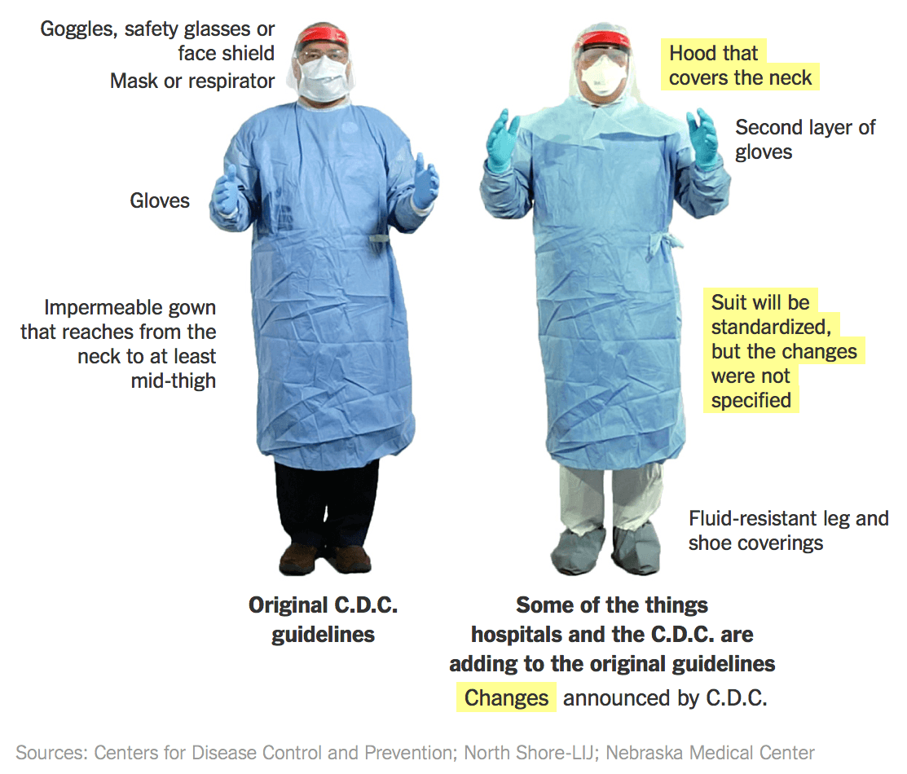
Echipamentul Personal de Protejare
Standardele pentru personalul nursing:
Față de mască N95 or sau respirator de aer controlat
Față de mască și blindaj
Halat impermeabil de unică folosință
Mănuși nesterile
Huse pentru încălțăminte
Notes:
Our priority from the beginning has been to keep staff safe and to safely care for patients. For safety, we follow the CDC protective equipment standards. This includes wearing an N95 mask or CAPR to ensure COVID is not breathed in by the staff as they care for patients, along with a face shield, gowns, gloves, and shoe covers. The CAPR is a respiratory protective device that creates negative pressure when worn. This slide gives a visual overview of the personal protective equipment used at Cone Green Valley Hospital.

Slide 5
Siguranța și eficiența personalului Nursing
Igiena mâinilor înainte și după fiecare interacțiune a pacientului și mănuși noi.
Personalul Donning & Doffer.
Durată mai mare de purtare a echipamentului și mai puține modificări ale halatului = risc redus de contaminare a personalului.
Halate chirurgicale din pânză refolosibile în loc de halate de unică folosință.
Controlul temperaturii unității pentru a preveni încălzirea personalului.
Procesul de decontaminare a măștii N95, astfel încât măștile să poată fi refolosite.
Notes:
Caring for patients in an all COVID hospital has required us to find solutions to ensure staff safety. Opening an all covid hospital was the first solution. Another solution was the extended use personal protective equipment. Our staff use their protective equipment for extended time periods as they care for patients; however, after each patient interaction they perform hand hygiene and put on clean gloves. By decreasing the amount of times staff take off dirty equipment we are decreasing the risk of the staff self-contaminating themselves with COVID and increasing time nurses can spend with patients. Since ll patients at our hospital already have Covid-19, the risk of transmission of the virus to other patients is not highest priority; preventing transmission to staff remains a priority. At other hospitals, patients with COVID are on units with other patients who do not have COVID patients. In those units, nurses are putting on and taking off the protective equipment every time they enter and exit the patient room. The extended use process at Green Valley allows us to conserve our protective equipment to ensure we continue to have ample supply, continue to keep staff safe, and ensure timely staff response to patients. Some other creative solutions that we have developed into our practices at Green Valley Campus also include the use of reusable surgical gowns instead of disposable plastic gowns. The surgical gown comes in various sizes, is longer than the plastic gown, and keeps staff cooler than the plastic gown. Ensuring staff are safe when they go home to their families is another priority. We provide our teams with scrubs that they only wear at Green Valley and with an option to shower prior to going home. Finding creative solutions at Green Valley has involved both clinical and non-clinical staff. Our environmental facilities team has helped keep temperatures cool so staff do not get over-heated when wearing the PPE. We also us non-clinical staff as observers when nurses ae putting on and taking off PPE to their safety. We also developed a decontamination process for our N-95 masks.

Slide 6
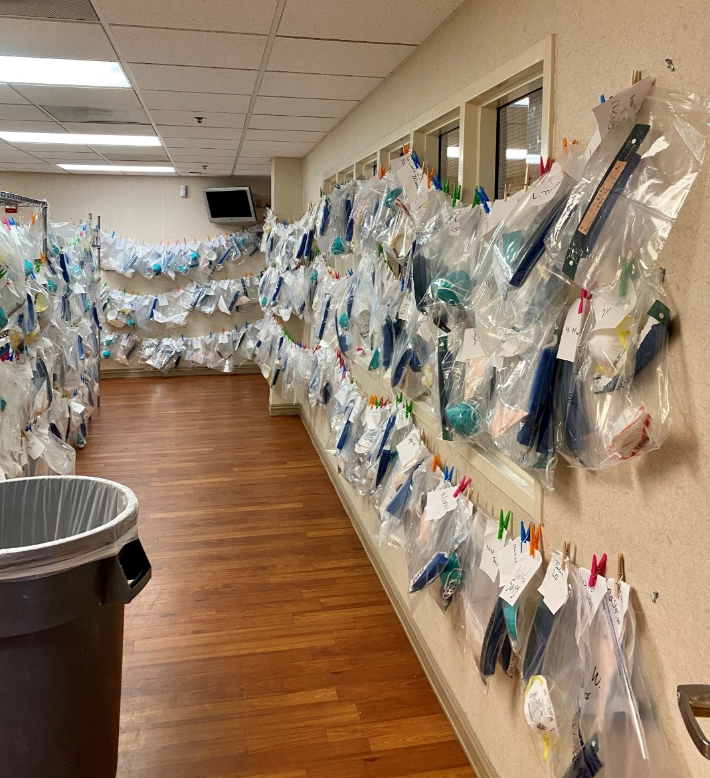
Proceudra de decontaminare a măștilor
Măștile sunt puse în pungi de hârtie atunci când sunt murdare / folosite.
Măștile sunt tratate cu raze ultraviolete timp de 15 minute cu ajutorul unui robot.
Măștile sunt returnate aceleiași nurse într-o pungă transparentă - masca este curată și gata de utilizare.
Notes:
At Cone Green Valley we utilize an Ultraviolent light (UV) decontamination process for our N-95 masks in order to reduce waste and preserve personal protective equipment. Staff members enter the building and pickup their masks prior to starting work. These masks are checked out and a record is kept of how many shifts the team member has used it. The mask is inspected for any damage or soiling that could impact performance. After their shift is complete a check in process is used and these masks are sent for UV decontamination.

Slide 7
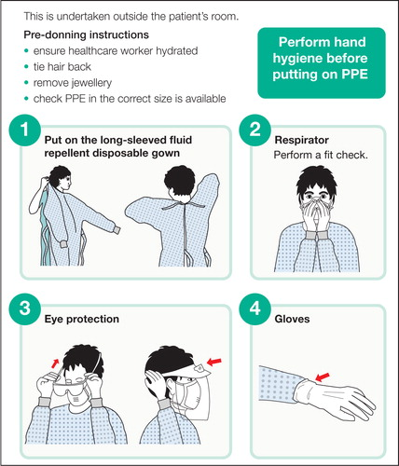
Procedurile Donning & Doffing
Acest video YouTube arată cum folosim echipamentul de protecție
https://www.youtube.com/watch?v=cCzwH7d4Ags
Notes:
We will now watch a short video on how to don and doff personal protective gear.

Slide 8
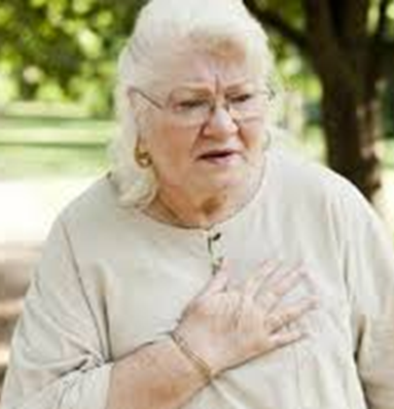
Studiu de caz
Dna Smith, femeie de 62 ani
Văduvă, trăiește cu fiica sa, ginerele, și nepotul.
S-a prezentat la urgență.
Primele simptome:
  Greață, diaree, slăbiciune, oboseală, febră, tuse uscată, și dificultăți de respirație.
  Simptomele au apărut cîteva zile în urmă și starea s-a înrăutățit.
Test pozitiv la Covid-19:
  Expunere recentă la un membru al familiei (fiica) care a dat rezultate pozitive Covid-19.
Notes:
Now that we have presented a foundational understanding of the environment at our COVID hospital, we will begin to review our case study.
A 62-year-old female presented to the emergency room complaining of shortness of breath. Her shortness of breath had worsened over the last week. She had recent exposure to a family member who later tested positive for COVID-19. Common early symptoms of COVID-19 include a loss of taste or smell, a cough with upper respiratory symptoms, fever. Less frequently symptoms can include confusion and gastrointestinal symptoms. Much of this data is provided through free national and international COVID research banks. The one Cone Green Valley references most frequently is Covidprotocols.org, which is associated with Brigham and Women’s Hospital in Boston, Massachusetts.
Arentz M, Yim E, Klaff L, et al. Characteristics and Outcomes of 21 Critically Ill Patients With COVID-19 in Washington State [published online ahead of print, 2020 Mar 19]. JAMA. 2020;323(16):1612-1614. doi:10.1001/jama.2020.4326
Chen N, Zhou M, Dong X, et al. Epidemiological and clinical characteristics of 99 cases of 2019 novel coronavirus pneumonia in Wuhan, China: a descriptive study. Lancet. 2020;395(10223):507-513. doi:10.1016/S0140-6736(20)30211-7

Slide 9
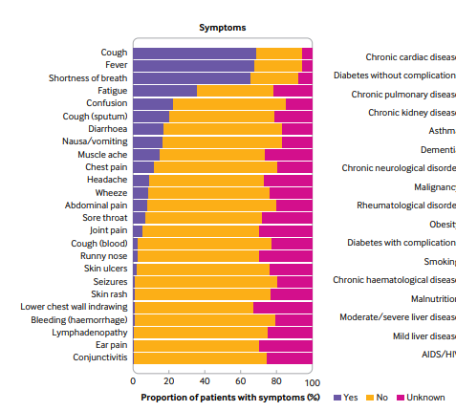
Simptome generale Covid-19
Source: Docherty et al., 2020
Notes:
This table shows the top symptoms that affect Covid-19 patients. The top 3 symptoms that affect over half of patients include dry cough, fever, and shortness of breath.
Other important symptoms are fatigue, confusion, productive cough, nausea/vomiting/diarrhea, and muscle aches, chest pain and headache.

Slide 10
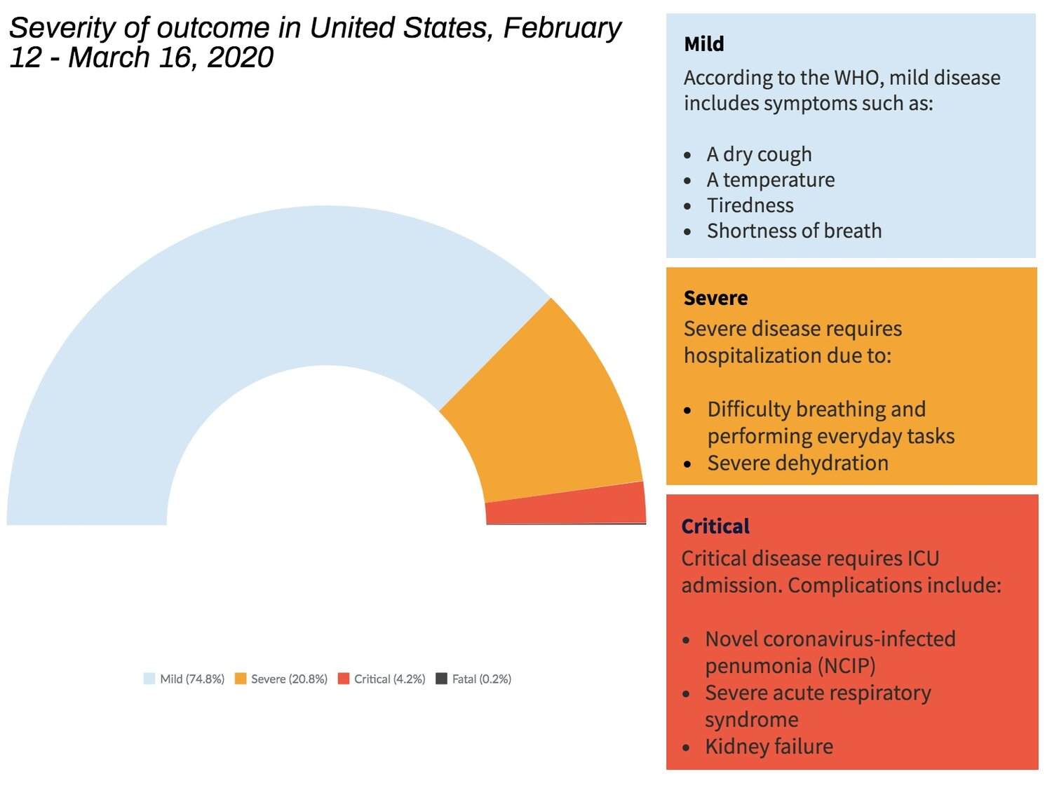
Gravitatea bolii Covid-19
Notes:
This chart shows the symptom presentation for mild, severe, and critical Covid-19 symptoms.
Mild disease includes a dry cough, fever, fatigue, and shortness of breath.
Severe disease requires hospitalization and includes difficulty breathing and performing everyday tasks and severe dehydration.
Critical disease requires intensive care and includes severe pneumonia and acute respiratory syndrome and kidney failure.

Slide 11
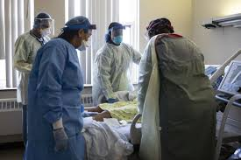
Istoric medical
Istoricul Dei Smith:
Hipertensiune arterială
Obezitate
Osteoartrită
Istoric de cancer mamar
Nefumătoare
Factorii de risc Covid-19:
Vârstă înaintată
Hipertensiune arterială
Diabet
Obezitate
Cancer
Boala arterei coronare
Boli cronice pulmonare, astmă
Boli cronice renale
Demență
Notes:
The patient’s past medical history included obesity, breast cancer, and uncomplicated high blood pressure. She was a non-smoker and had no history of pre-existing lung disease.
Obesity, defined as a body mass index of greater than 25, is a common denominator in many of our COVID-19 patients. Other common pre-existing conditions include cancer, diabetes, high blood pressure and pre-existing heart and lung conditions. The pathophysiology of COVID-19 has not been fully determined yet, but there are some indications that these diseases can increase the severity of disease.
Fang L, Karakiulakis G, Roth M. Are patients with hypertension and diabetes mellitus at increased risk for COVID-19 infection? [published correction appears in Lancet Respir Med. 2020 Jun;8(6):e54]. Lancet Respir Med. 2020;8(4):e21. doi:10.1016/S2213-2600(20)30116-8
Zhou F, Yu T, Du R, et al. Clinical course and risk factors for mortality of adult inpatients with COVID-19 in Wuhan, China: a retrospective cohort study [published correction appears in Lancet. 2020 Mar 28;395(10229):1038] [published correction appears in Lancet. 2020 Mar 28;395(10229):1038]. Lancet. 2020;395(10229):1054-1062. doi:10.1016/S0140-6736(20)30566-3
Zhang JJ, Dong X, Cao YY, et al. Clinical characteristics of 140 patients infected with SARS-CoV-2 in Wuhan, China. Allergy. 2020;75(7):1730-1741. doi:10.1111/all.14238

Slide 12
Rezultate de Laborator & Radiologie
Pacienții cu test pozitiv Covid-19:
Presiunea oxigenului scăzută: gaz arterial din sânge PO2 (59; normal este 80-100)
Electroliți anormali: potasiu scăzut și sodiu scăzut
Anemie - hemoglobină scăzută
Problemă de coagulare a sângelui: D-dimer ridicat
Inflamație: fier seric ridicat și CRP
Radiografie toracică anormală
Notes:
Laboratory markers are frequently being utilized to trend the course of COVID-19 and to attempt to predict which patients are most at risk for complications. Some commonly abnormal laboratory values include elevated non-specific inflammatory markers, which are useful in trending the course of the illness. Some of the suspected pathophysiology of acutely ill COVID-19 patients is related to inflammatory cascades. These markers confirm or track this process. D-Dimer, is a fibrin degradation product and is a residual protein fragment present after a blood clot is dissolved. Tracking this value is becoming common with COVID-19 patients to indicate the severity of disease or rule out underlying pulmonary emboli. It is currently unclear why D-dimers are markedly elevated in COVID-19 patients.
Watching for signs of end organ damage is also a useful tool for laboratory markers. Kidney and liver acute injuries are common among patients with COVID-19.
The nurse should generally be familiar with arterial blood gas values and how to interpret them.
Arentz M, Yim E, Klaff L, et al. Characteristics and Outcomes of 21 Critically Ill Patients With COVID-19 in Washington State [published online ahead of print, 2020 Mar 19]. JAMA. 2020;323(16):1612-1614. doi:10.1001/jama.2020.4326
Zhou F, Yu T, Du R, et al. Clinical course and risk factors for mortality of adult inpatients with COVID-19 in Wuhan, China: a retrospective cohort study [published correction appears in Lancet. 2020 Mar 28;395(10229):1038] [published correction appears in Lancet. 2020 Mar 28;395(10229):1038]. Lancet. 2020;395(10229):1054-1062. doi:10.1016/S0140-6736(20)30566-3
Lactate Dehydrogenase (LDH) can be predictive of severity and mortality (Henry, B. M., Aggarwal, G., Wong, J., Benoit, S., Vikse, J., Plebani, M., & Lippi, G. (2020). Lactate dehydrogenase levels predict coronavirus disease 2019 (COVID-19) severity and mortality: A pooled analysis. The American journal of emergency medicine, 38(9), 1722–1726. Advance online publication. https://doi.org/10.1016/j.ajem.2020.05.073)
pH (7.35-7.45)
PaO2 (75-100 mmHg)
PaCO2 (35-45 mmHg)
HCO3 (22-26 meq/L)
Base excess/deficit (-4 to +2)
SaO2 (95-100%)
pH = measured acid-base balance of the blood
PaO2 = measured the partial pressure of oxygen in arterial blood
PaCO2 = measured the partial pressure of carbon dioxide in arterial blood
HCO3 = calculated concentration of bicarbonate in arterial blood
Base excess/deficit = calculated relative excess or deficit of base in arterial blood
SaO2 = calculated arterial oxygen saturation unless a co-oximetry is obtained, in which case it is measured

Slide 13
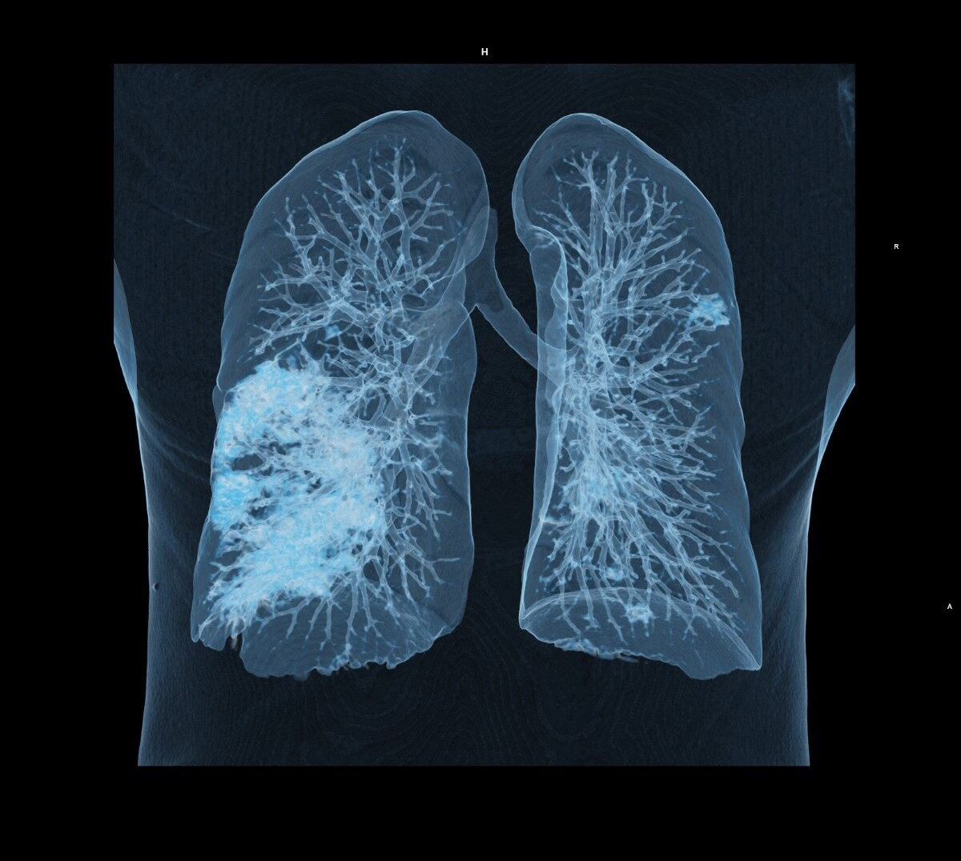
Radiografia plămânilor afectați de Covid-19
Plămânii se umplu cu lichid, limitându-le capacitatea de a lua oxigen.
Se dezvoltă pneumonia, provocând dificultăți de respirație, tuse și alte simptome.
Probleme pulmonare, cum ar fi dificultăți de respirație, pot persista după recuperarea pacientului.
Notes:
Radiological or x-ray findings common in early Covid-19 patients are a bilateral atypical pneumonia. Patients presenting to the hospital with these signs on radiological films should be treated with a high index of suspicion.

Slide 14
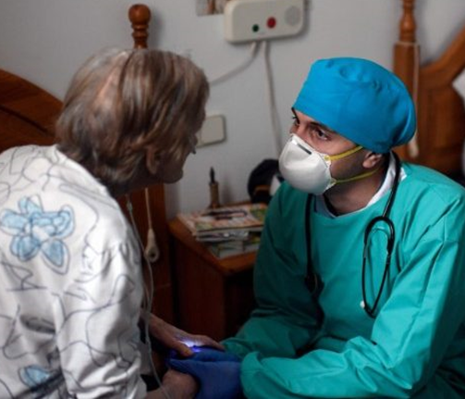
Evaluarea Nursing la spitalizare
Doamna Smith era alertă și orientată, dar îngrijorată de faptul că se afla în spital
Era îngrijorată de faptul că era departe de familia ei
Îi era teamă să nu-și revină sau să-și revadă familia.
Fiica ei a dat rezultate pozitive pentru Covid-19, dar a avut simptome ușoare.
Notes:
On the initial nursing assessment Mrs. Smith was alert and oriented but anxious. Many Covid-19 patients are worried about not seeing their families again, or about the possibility that they have infected those they love.
Wu Z, McGoogan JM. Characteristics of and Important Lessons From the Coronavirus Disease 2019 (COVID-19) Outbreak in China: Summary of a Report of 72 314 Cases From the Chinese Center for Disease Control and Prevention [published online ahead of print, 2020 Feb 24]. JAMA. 2020;10.1001/jama.2020.2648. doi:10.1001/jama.2020.2648
Song F, Shi N, Shan F, et al. Emerging Coronavirus 2019-nCoV Pneumonia. Radiology 2020 Feb 6:200274

Slide 15
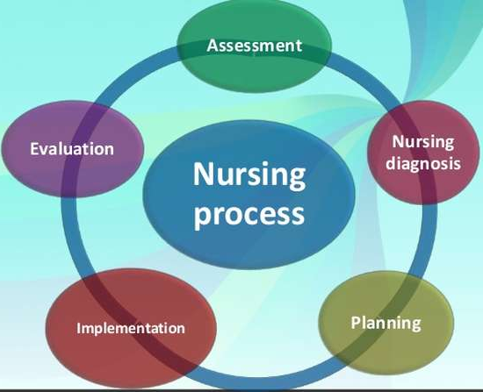
Procesul Nursing și planul de îngrijire
Comunicarea și coordonarea cu asistenții medicali, medicul și alți membri ai echipei.
Plan de îngrijire individualizat, centrat pe persoană.
Notes:
The nursing process is used t guide our nursing assessment, identification of nursing problems, developing and implementing the plan of care, and evaluating the patient’s response to that care and making changes to improve the care plan.
The nursing process relies on good communication with doctors, nurses and other team members in order to provide high quality person-centered, individualized care.

Slide 16
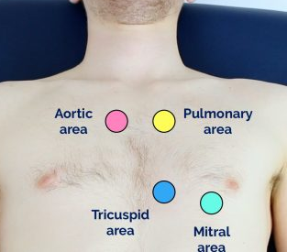
Evaluarea Nursing:
Cardiovasculară
EVALUARE:
Auscultație cardiacă: ritm rapid, 100 de bătăi pe minut, ritm regulat, fără murmur sau galop.
Sânge scăzut, cu scăderea tensiunii arteriale când se ridică.
Impulsuri la nivelul picioarelor, fără semne de tromboză venoasă profundă (sensibilitate).
INTERVENȚII NURSING:
Monitorizarea tensiunii arteriale și pulsului.
Monitorizarea ritmurilor cardiace anormale.
Încurajarea exercițiilor pentru picioare pentru a preveni formarea cheagurilor.
Administrarea medicamentelor pentru tensiunea arterială și anticoagulante pentru subțierea sângelui.
Notes:
Tachycardia is common as a compensatory mechanism in response to hypoxemia. Blood pressure can vary depending on whether the patient is entering a shock-state. Assessment for perfusion to the extremities, capillary refill and palpation of the lower extremities for signs of deep vein thrombosis is necessary. Monitoring, assessments, frequent movements, and attention to medication administration is needed.

Slide 17
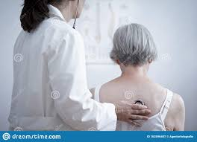
Evaluare Nursing:
Respiratorie
EVALUARE:
Pacientul este palid cu respirație greoaie și tuse uscată, frecvență respiratorie> 30 respirații pe minut
Auscultație: scăderea sunetelor pulmonare, raluri.
Nivel scăzut de oxigen: Sp02 de 62% pe aerul din cameră (normal este> 92%)
INTERVENȚII NURSING:
Mască de față fără respirație, oxigen la 15L / min
Întoarcerea și repoziționarea, tuse și respirație profundă, poziționare predispusă.
Activități pentru a preveni agravarea respirației.
Monitorizarea semnelor de cheaguri de sânge în plămâni: dificultăți de respirație crescute, dureri în piept, niveluri scăzute de oxigen din sânge, delir.
Notes:
On physical examination the patient was noted to show signs of low oxygen levels with a low sp02 (fraction of oxygen-saturated hemoglobin relative to total hemoglobin in the blood) of 62% on room air. The patient was placed on a non-rebreather facemask. She had no current fever, chills headache, vision changes, problems swallowing or chest pain. She had no blood in stool or urine and no rashes, no numbness, tingling or joint pain.
Nursing assessment points for hypoxemia (low oxygen levels) in the absence of monitoring can include looking for trends or changes in the patients’ ability to speak or finish a sentence. Observing for sweating, retractions, or increased physical work to breath. Anxiety, restlessness and tachycardia can be signs of early hypoxemia. A fragile respiratory status often deteriorates with exertion. Lung sounds are often diminished with rales in the bases. Late signs of decreased oxygenation, or hypoxia, can be bradycardia, confusion, cyanosis, cool clammy skin, diaphoresis (sweating), and mental status changes.

Slide 18
Acțiuni întreprinse
SCOPUL
Pentru a crește expansiunea pulmonară și oxigenarea.
Pentru a preveni sindromul de detresă respiratorie acută.
CRITERII:
Auto-pronarea poate fi utilizată la pacienți stabili (pe aerul din cameră sau pe oxigen suplimentar) și ca „salvare” pentru cei care au cerințe crescute de O2.
Este necesară discuția cu medicul, asistentul medical și terapeutul.
Pacientul trebuie să poată circula independent
Notes:
We have learned that many COVID-19 patients are able to tolerate much lower sp02 levels, for much longer. The bedside nurse must learn how to change their expectations and allow the patient to be in "happy hypoxemia". The bedside nurse should not get nervous until the work of breathing has changed and is unresolved with rest or minimal intervention. One intervention to improve oxygenation the nurse can promote is self-proning.
We are going to look at Cone’s self proning protocol, which was taken from Brigham and Women’s Hospital and Harvard University.
Patients are eligible for self-proning only if they are stable or as a "rescue" for those who have escalating supplemental O2 requirements. Multidisciplinary discussion is required with provider, RT, and RN. The patient must be able to move independently and have the cognitive and physical status to supinate (roll back to their back) themselves if they become uncomfortable. This includes the ability to prone/supinate while safely managing their supplemental oxygen, IV tubing, SpO2 monitor and other leads and attachments (within reason).
Contraindications to proning include the inability to independently supinate or pronate safely, an imminent risk of intubation, a spinal instability, facial or pelvic fractures, open chest, abdomen, or unstable chest wall.

Slide 19
Protocol
Asistentul medical documentează poziția predispusă / decubit cu fiecare verificare a semnelor vitale.
Documentarea semnelor vitale:
- Schimbarea poziției
- Evaluarea pacientului dacă are probleme cu respirația
- Verificarea nivelurilor de oxigen
Tratamentul cu oxigen folosind mască de față, după cum este necesar
Încercați să predicați la fiecare 4 ore și rămâneți predispus atât timp cât pacientul poate tolera.
Protocolul este adesea scurtat din cauza disconfortului pacientului, dar trebuie încurajat să ajungă la 1-2 ore.
Obiectiv: predispus la 16 ore pe o perioadă de 24 de ore.
Notes:
Ideally, we are proning patients for 16 hours a day. Though, the patient may choose to stop self-proning at any time. The nurse can work with the patient in order to provide education. If intubation is within a patient’s goals of care, consider ceasing proning if the patient has an escalating oxygen requirement leading to concern for intubation. Self-proning can be done while on Venturi mask or Non-Rebreathing Mask (NRB) with multi-disciplinary discussion for safety.
The nurse should document prone/supine with every vital signs check and a subjective assessment of their work of breathing, respiratory rate, Sp02 (ABG not required), oxygen device and flow rates. The goal or these assessments are to identify which patients respond to this treatment using objective and subjective criteria.
The nurse should encourage the patient to prone for 16 hours a day, but this can be done in achievable goals, like 1-2 hours at a time.

Slide 20
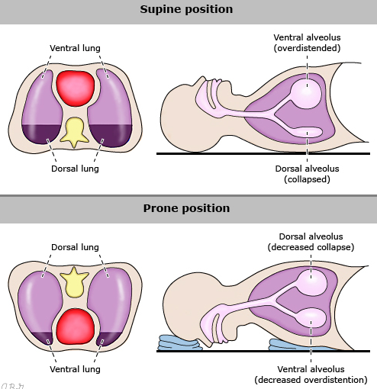
Rezultatele Pacientului:
Îmbunătățește ventilația și expansiunea pulmonară și eliminarea secreției.
Notes:
Proning is thought to provide physiologic benefits for patients with COVID-19 infection. Proning improves recruitment of alveoli in dependent areas of the lungs and may improve perfusion to ventilated areas, improving V/Q mismatching. Typically, proning is used in ventilated ICU patients, however the same benefits may accrue to non-ventilated patients.

Slide 21
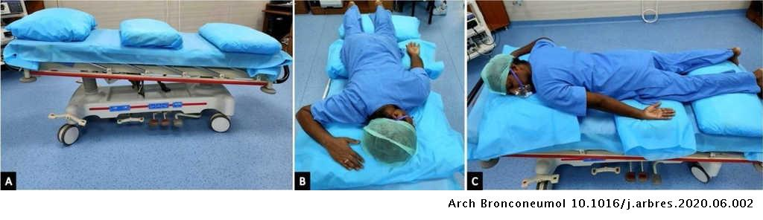
Poziții
Notes:
In order to properly prone, the nurse should have the patient lay on their abdomen (arms at sides or in "swimmer" position). If a patient is unable to tolerate, they may rotate to lateral decubitus or partially position to the side (in between proning and lateral decubitus) using pillows or waffle cushioning as needed. Ideally the patient should be fully proned rather than on the side as there is currently no data about whether side positioning is beneficial.

Slide 22
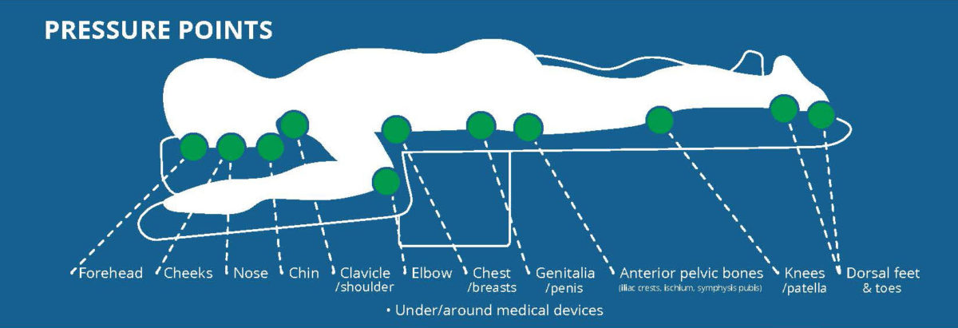
Evaluarea tuturor punctelor de presiune.
Schimbările mici de poziție trebuie efectuate în timp ce sunt pronunțate.
Sunt necesare dispozitive / perne pentru a descărca punctele de presiune.
Notes:
Frequent proning and paralytic use has led to patient deconditioning and the opportunity for skin breakdown in many patients. This is unavoidable in some circumstances. However, there are a number of interventions the nurse can take. We can place protective padded dressings on bony prominences before proning patients. We turn the head and body of patients every two hours. We turn immobile patients off pressure spots every 2 hours. We promptly clean incontinent patients and utilize sacral pads.

Slide 23
Procesul Nursing:
Statut mental
EVALUARE:
Oxigenarea scăzută crește riscul de delir.
Nivelul conștiinței: orientat spre sine și loc, dar nu spre zi sau timp; agitat și neliniștit.
Pacientul își poate comunica nevoile.
INTERVENȚII:
Comunicare, spuneți pacientului ce se întâmplă, asigurați siguranța cu privire la îngrijirea acestuia.
Calendar și ceas în cameră.
În timpul zilei: lumina zilei pe timp de zi și asigurați o perioadă liniștită pentru odihnă.
În timpul nopții: păstrați camera întunecată și liniștită, arătați cum să utilizați lumina de apel pentru a apela la asistență.
Comunicarea cu familia sa - telefon, iPad.
Notes:
It is important for the nurse to be able to assess for mental status changes. Low oxygenation increases the risk for delirium and can be an important indicator that someone is at risk for going into acute respiratory failure. Covid-19 patients have a prolonged length of stay in the hospital and longer duration of mechanical ventilation and sedation. This can cause changes in cognition and perceptual disturbances, otherwise known as delirium. Delirium is associated with decreased survival and increased cognitive dysfunction. Some of the preventative measures we take at Cone Green Valley hospital to reduce delirium are decreasing sedative use when appropriate; We encourage meaningful interactions and natural lighting during daytime hours. Activities, such as reading, music, or puzzles to keep patients engaged.

Slide 24
Evaluare Nursing:
Sistem abdominal - gastrointestinal și urinar
EVALUARE:
Abdomen rotund, moale, activitate intestinală.
Greață ușoară și cantitate mică de diaree.
Urină galben închis folosind comoda de la noptieră.
INTERVENȚII:
Ajutarea pacientului să folosească toaleta la fiecare 2 ore.
Monitorizarea diareei.
Monitorizarea semnelor de deshidratare.
Utilizarea diureticelor
Notes:
Complications from Covid-19 can be fatal. Early and effective identification and treatment of organ failure, fluid overload, sepsis, pneumonia or other healthcare associated infections are paramount. Kidney failure and gastrointestinal symptoms are common. The nurse should monitor and frequently assess for signs of dehydration, diarrhea, constipation, or kidney failure. Diuretics are frequently used to decrease the fluid buildup at the site of gas exchange in the lungs.

Slide 25
Evaluare Nursing:
Nutriție și Deshidratare
EVALUARE:
Pacientul este amețit, obosit, slab, are cefalee, este iritabil.
Testele de laborator arată dezechilibru electrolitic (scăzut de potasiu și sodiu); piele și gură uscate, urină de culoare închisă.
Vor bea câteva lichide.
INTERVENȚII:
Încurajarea cantităților mici de lichide pe oră.
Soluții de rehidratare cu electroliți; să evite băuturile răcoritoare și băuturile dulci.
Consultarea unui dietetician pentru a identifica preferințele alimentare.
Terapie intravenoasă până la administrarea de lichide suficiente.
Monitorizarea admisiei și ieșirii.
Monitorizarea temperaturii pentru febră.
Notes:
Fluid imbalances are common in Covid-19 patients. Increased permeability of the membranes in the lungs can cause fluid buildup and poor gas exchange, worsening hypoxemia. Decreased intake and increased metabolic states (as in sepsis or fever) can worsen dehydration. The nurse should monitor for all of these complications and take steps to increase intake, decrease fever, and/or advocate for medication changes.

Slide 26
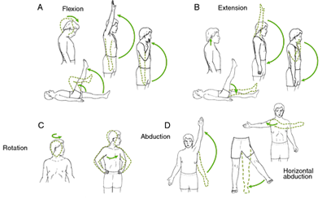
Proces Nursing:
Mobilitate
EVALUARE:
Pacientul este slab, are nevoie de susținere de mișcare în pat.
Hipotensiune ortostatică, instabilitate pe picioare, risc de cădere.
Osteoartrită - rigiditate si dureri articulare.
INTERVENȚII:
Ajutarea cu mișcarea la brațe și picioare de 2 ori pe zi.
Șederea pe scaun cât este de posibil de tolerat.
Ambulare progresivă - în cameră și hol de 4 ori pe zi.
Medicație pentru durerea de artrită pentru a permite mobilitatea.
Notes:
The nurse should be mindful of the importance of mobility and movement, but also that hypoxemia is common and can be tolerated within reason in Covid-19 patients. Allowing for "happy hypoxemia" is a strategy to prevent invasive ventilation, improve mobility and decrease the likelihood for complications from decreased mobility such as development of a secondary pneumonia.

Slide 27
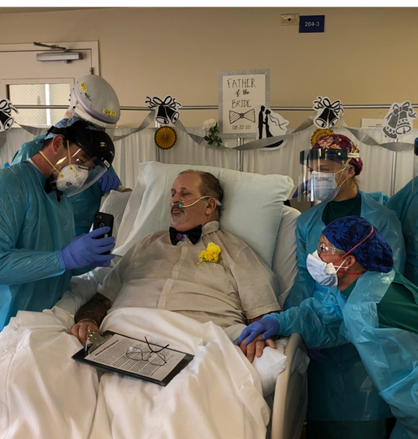
Proces Nursing:
Anxietate și Frică
EVALUARE:
Pacientul este foarte anxios, temător de moarte.
Îngrijorat că familia se poate îmbolnăvi.
Se simte singur și abandonat.
INTERVENȚII:
Susținere și încurajare.
Informații pozitive despre progresul și îmbunătățirea stării de sănătate.
Organizarea apelurilor telefonice cu familia.
Comunicarea planului de îngrijire.
Notes:
Post traumatic stress disorder can develop after a terrifying or traumatic event. In the case of Covid-19 this is of particular concern for patients who have a prolonged length of stay in an intensive care environment. Preventative efforts we utilize are journaling and daily connection with family via video chat.
This is a photograph of Mr. Thomas, one of our patients who was inpatient nearly 60 days. He had ARDS, was intubated, sedated, proned and paralyzed for many days. Our staff and his family were extremely guarded about his ability to survive his course of illness with Covid-19. He ultimately was able to recover enough to undergo a tracheostomy. His daughter was married during his time inpatient and he was able to attend via video conference. We were able to move him to a passey muir valve so he could speak at her wedding. These kinds of interactions are extremely important to both patients and staff as we process the impact of Covid-19. Reducing the feelings of isolation and fear can go a long way in preventing post-traumatic stress disorders.

Slide 28
Evaluare continuă Nursing pentru a monitoriza simptomele și complicațiile precoce
Delir
Căderi
Tromboză venoasă
Ulcer
Sindromul de insuficiență respiratorie acută
Sepsis
Notes:
These are some of the complications that can require more intensive medical and nursing interventions The biggest concern with Covid-19 is Acute respiratory distress syndrome or ARDS. This is an inflammatory lung condition which can result from a variety of intrapulmonary and extrapulmonary causes such as a viral infection like COVID-19 or influenza, trauma, aspiration, chemical or smoke inhalation, or certain medical procedures. In ARDS the lungs sustain extensive damage which causes blood and plasma to build up in the lungs and diminishes the body’s ability to oxygenate or ventilate. Blood oxygen levels can become dangerously low, therefore ARDS is typically considered a medical emergency.
Delirium and falls are a concern with low oxygen levels.
Covid-19 patients are hypercoagulable and are at risk for deep vein thrombosis, pulmonary embolis and stroke.
Rates of co-infections, such as superimposed bacterial pneumonias, and sepsis are common in Covid-19 patients. The nurse must continually assess for changes in the patient's status.

Slide 29
Recuperare după Covid-19
Aproximativ 80-85% dintre pacienții cu Covid-19 suferă de cazuri ușoare sau moderate de infecție.
Aproximativ 15-20% dintre pacienți prezintă simptome severe.
Aproape jumătate dintre pacienții spitalizați pot avea leziuni renale.
Poate dura până la 6 săptămâni pentru a se recupera complet de Covid-19, și chiar luni în cazuri severe.
Pentru cazurile moderate persistă lipsa respirației, oboseală și diaree.
Notes:
Recovery is slow with Covid-19 patients. Many will continue to have an apparent restrictive lung disease until healing is complete. Many Covid-19 patients, even those who do not meet the technical definition of ARDS will follow the same disease course which generally includes three phases: There is an exudative phase, which is when there is fluid buildup due to edema and increased permeability of the membranes. The next phase is fibroproliferative phase, where the body is beginning to heal itself. The final phase is a fibrotic phase, which is where the lungs become stiff and difficult to expand. Damaged alveoli continue to malfunction due to fluid buildup or fibrosis.
Where did you get the statistic that almost half of patient have kidney damage?

Slide 30
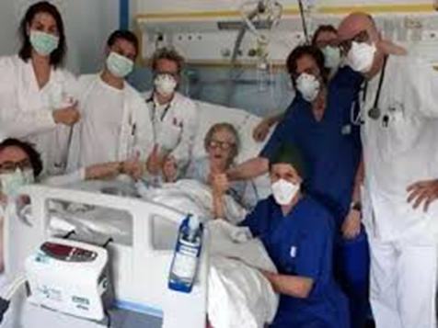
Protocol de externare
Standardul global impune, în general, pacienților să dea rezultate negative în 2 teste consecutive la 24 de ore distanță.
Protocoalele specifice variază în funcție de țară.
Centrele SUA pentru Controlul și Prevenirea Bolilor necesită cel puțin o săptămână pentru a trece de la primele simptome.
După externare, poate fi necesară o carantină de 14 zile.
Unii pacienți ar putea avea nevoie să meargă la o unitate de reabilitare pentru a se întări înainte de a pleca acasă.
Notes:
In the United States, we must have 2 negative tests 1 week apart in order for patients to go to an inpatient rehabilitation or nursing home. Other patients may be discharged to home quarantine after supportive care is no longer required.

Slide 31
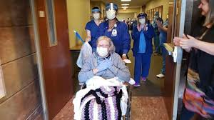
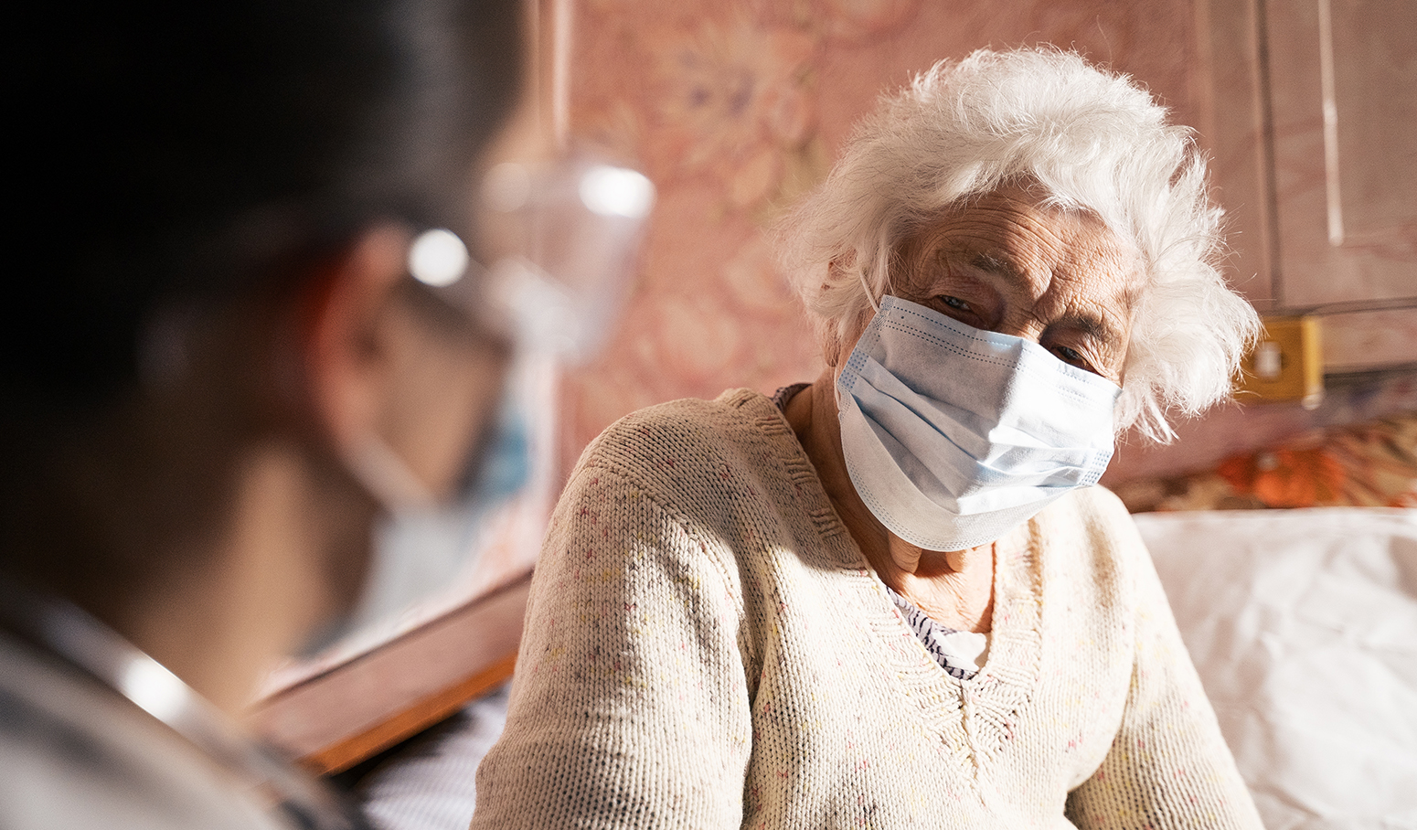
Rezultatele studiului de caz
Notes:
Mrs. Smith returned home with her two adult daughters on oxygen support after a three week stay at inpatient rehab. She continued to be weak for many months and required assistance with activities of daily living. She continues to recover at home

Slide 32
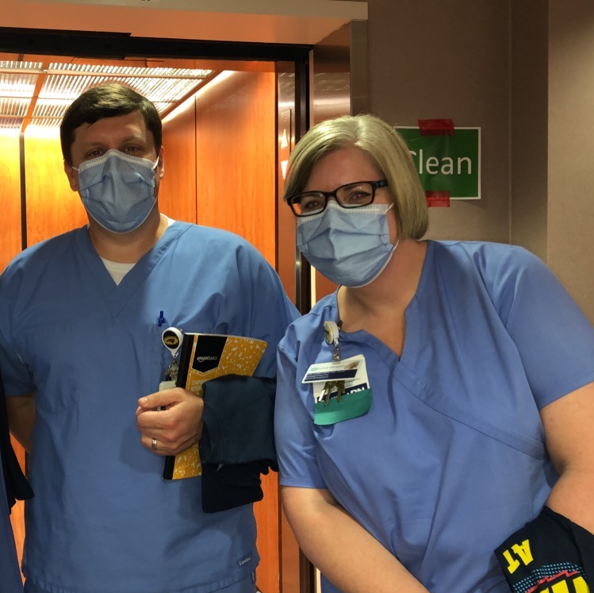
Comunicarea este importantă
Spitalul Cone Green Valley are numeroase nurse, medici, terapeuți respiratori și alți angajați care se dedică îngrijirii pacienților cu Covid-19.
Comunicarea este esențială în îngrijirea optimă a pacientului.
Informare după evenimente majore (cum ar fi înrăutățirea stării de sănătate a pacientului și transferul la terapie intensivă sau pacient decedat)
Îmbrățișări zilnice pentru încurajare
Comunicarea zilnică cu reprezentanții familiei pacientului - cu medicul, asistentul medical și alți membri ai echipei
Notes:
At Cone Green Valley we are so lucky to have an amazing group of volunteer clinical staff that answered the call to serve their community in this way. These are three of our amazing hospitalist physicians. Because of the stressful and often traumatic experience of caring for Covid-19 patients we have found it of the upmost importance to support and encourage our teammates to prevent clinician burnout and post-traumatic stress disorders. Some of the interventions we have taken to reduce stress is debriefing after major events and performing daily huddles and check-ins with staff. Daily communication with families is also a very meaningful activity and can help reduce feelings of helplessness.

Slide 33
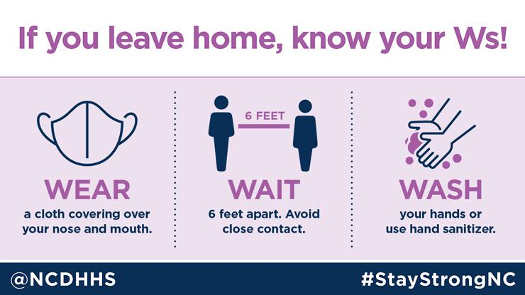
Întrebări și Dezbateri
Notes:
This image is confusing

